Slide 1



Financial Results
Presentation
Unaudited Financial Results (UFR) For the Nine Months / Quarter ended on 31st December, 2023
Gujarat Mineral Development Corporation Ltd.
(A Government of Gujarat Enterprise)
www.gmdcltd.com

Slide 2

INDEX
Performance Highlights
Financial Results
Segment-wise Performance

Slide 3


Performance Highlights

Slide 4


Nine Months/ Quarterly Performance Highlights
2nd Highest Turnover of Rs. 1713 Cr. for Nine Months
3rd Highest Profit Before Tax of Rs. 560 Cr. for Nine Months
3rd Highest Turnover Of Rs. 564 Cr. for 3rd Quarter
Market Capitalization zoomed from Rs. 4,664 Cr. to Rs. 12,943 Cr. in one year (31-Dec-2022 to 31- Dec -2023)
Highest Ever share price of Rs. 502.90 per share
469th rank in India’s fortune 500 Companies
Approval of mining plan of Damlai having lignite reserves of 57 million MTs
Approval of mining plan of Ambadungar having fluorspar reserves of 4.50 Million MTs

Slide 5
Last Five Years Revenue & PBT Highlights for Nine Months

Slide 6
Last Five Years Revenue & PBT Highlights for Q-3

Slide 7
Financial Results

Slide 8
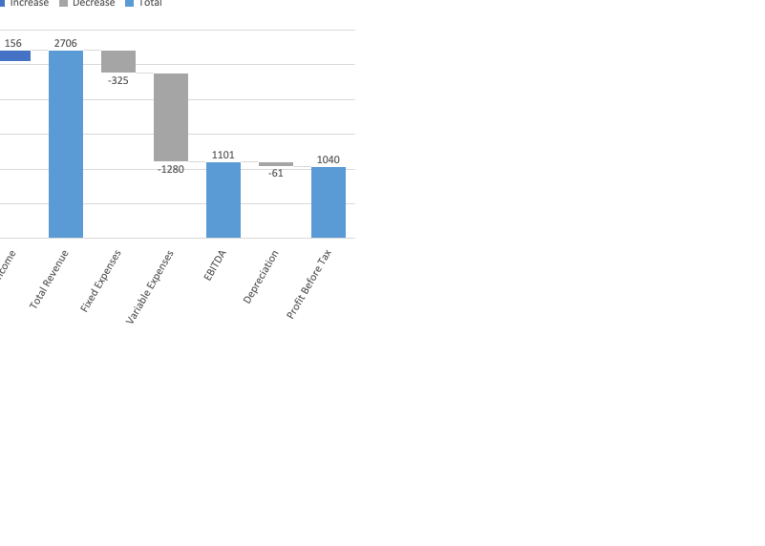
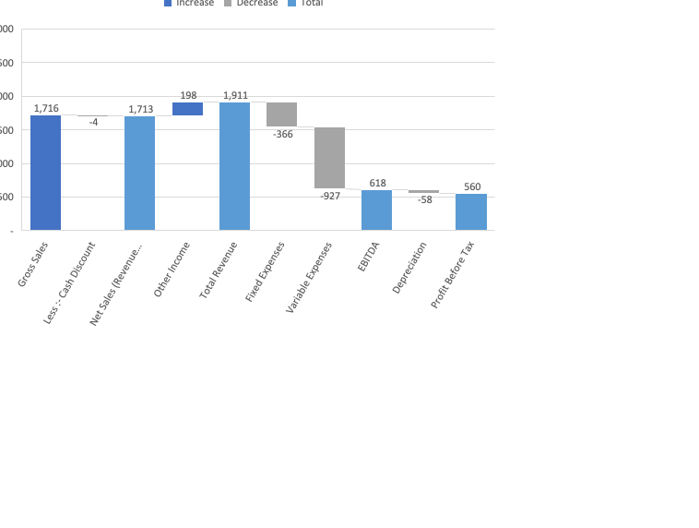
Financial Results
For the Nine months ended 31st Dec, 2023
32%
41%

Slide 9
Financial Results
For the Nine Months ended 31st December, 2023
(Rs.in Crore)

Slide 10
Project-wise Sales Analysis

Slide 11
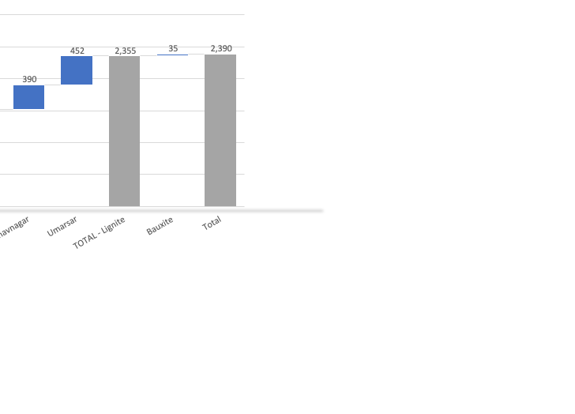
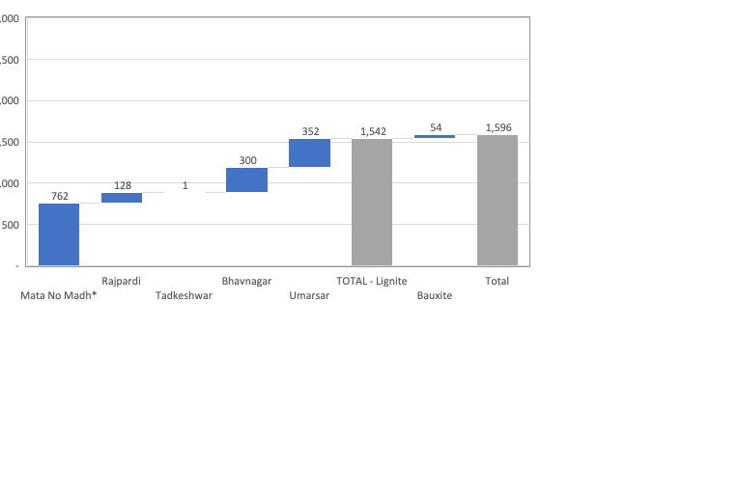
Project-wise Sales Analysis – Mining
(For the Nine Months ended 31st December, 2023)
Production (MT in lakh)
Production (MT in lakh)
22.92
1.94
0.01
8.31
9.93
43.11
2.14
45.25
25.10
4.90
6.01
8.53
11.26
55.78
1.48
57.26
Rs. In Cr.
Rs. In Cr.

Slide 12
Project-wise Sales Analysis – Mining
(For the Nine Months ended 31st December, 2023)
(Rs.in Crore)

Slide 13
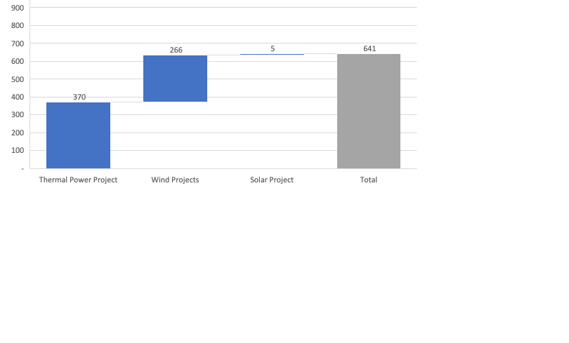
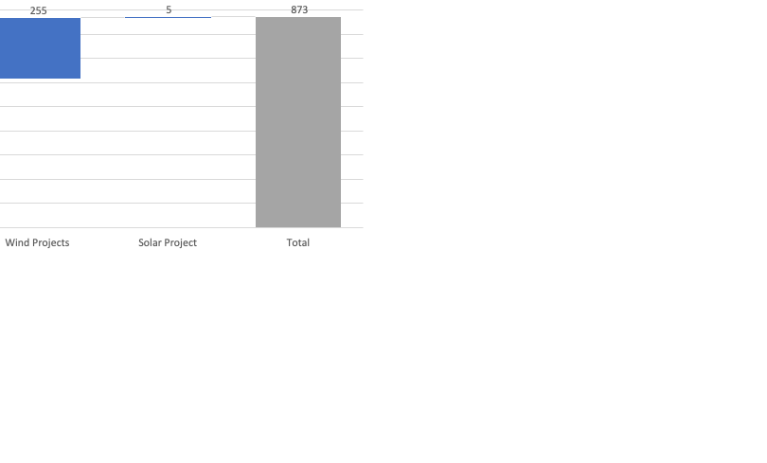
Project-wise Sales Analysis – Power
(For the Nine Months ended 31st December,2023)
Installed Capacity (MW)
250
201
5
250
201
5
Power Generation (MUs)
370
266
4.96
613
255
4.96
PLF / CUF
22%
20%
15%
37%
19%
15%
Rs. In Cr.
Rs. In Cr.

Slide 14
Project-wise Sales Analysis – Power
(For the Nine Months ended 31st December,2023)
(Rs.in Crore)

Slide 15
Segment-wise Performance

Slide 16
Segment-wise Performance
Up to Nine Months ended 31st December,2023
(Rs.in Crore)

Slide 17
Thank You
Gujarat Mineral Development Corporation Ltd.
(A Government of Gujarat Enterprise)
www.gmdcltd.com

